Slide 1



Slide 2
FOLIO3 SUMMER INTERNSHIP
Team D:
Ali Ahmed Samoo
M.Abdullah Siddiqui
Muhammad Asad
Muhammad Haroon
Komal Ayub

Slide 3
PROJECT TITLE:
RENT A CAR

Slide 4
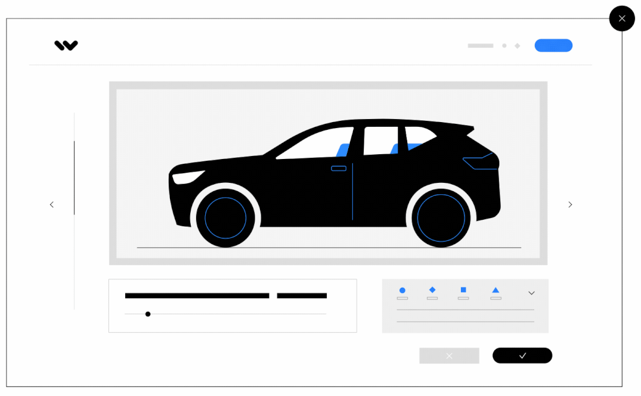
RENT A CAR

Slide 5
OVERVIEW:
Introduction
Users
Objectives
Project Scope
Tools
Functional Requirements
Conclusion

Slide 6
INTRODUCTION:
This is “Rent a Car” project which will provide a lot of facilities to their users.
It will record the detail of various activities of customers as well as information about booking .
It will simplify the task and reduce the paper work.
Registration of customer
Record of car booking
Record of all cars.
As a owner of a car ,you have to register your car.During the registration of a car ,all the detail or information of a car will be given.
As a customer(rentor) ,you also need to register. Search for car ,select car.

Slide 7
USERS:
Admin
Customer
Rentor
Car Owner

Slide 8

LOGO:

Slide 9
Objectives
The main objectives of the project are:
This project will help the administration to maintain all details of the customer ,car, and booking.
User friendly website.
To create a website that will allow car owner to register their car online for rent.
To establish a website that will allow rentors to register and rent cars online.
To create a website that can advertise cars for rent online.
To create a system that will reduce paper work and consume less time.

Slide 10
PROJECT SCOPE:
The scope of the project product developed involves paid services to the customers for rent a number of cars that are being offered.
It involves a very simple registration procedure.
Provide car catalog for users as an alternative for them to select car if they want to choose car by their owner.

Slide 11
MAIN TOOLS
The implemented website is written in react js(front-end) and node js (back-end).
Open source
High-performing scientific libraries
Data are stored in a MongoDB database
Open source
NoSQL
Dynamic schema

Slide 12
FUNCTIONAL REQUIREMENTS:
Add car
Add customer detail
Show car
Update charge of rent
Show all customer
Search information of car
Car Book information
Delete car information

Slide 13
FUNCTIONAL REQUIREMENTS:
Availability:
The system should always be available for access at 24 hours, 7 days a week. also int he occurrence of any major system malfunctioning, the system should be available 1 to 2 working days, so that the business process is not severely affected.
Performance:
The system response time for every instruction conducted by the user must not exceed more than a minimum of 10 seconds. The system should be high performance with a short span usually 50 second for high complected task.
Security:
The system provides username and password to prevent the system from unauthorized access. The staff’s password must be greater than eight characters. The subsystem should provide a high level of security and integrity of the data helped by the system, only the authorized personal of the company can gain access to the company's secured page of the system.

Slide 14
SOFTWARE REQUIREMENTS:
Visual Studio .Net 2010
MONGO DB(Database – Backend)
Windows 10
REACT JS(Form Design – Frontend)
VB.NET (Coding)

Slide 15
SCREENSHOTS

Slide 16
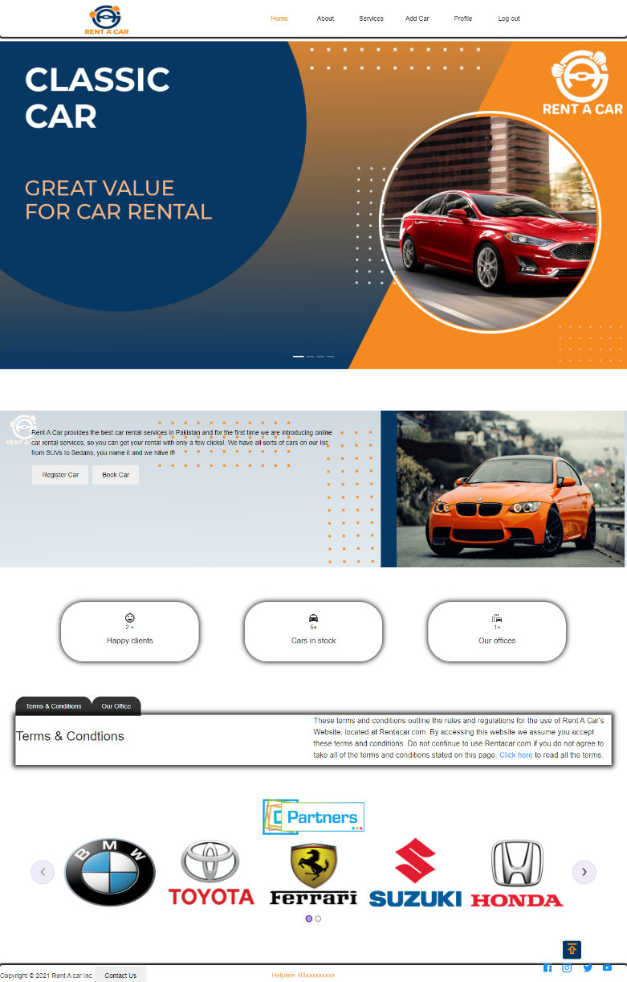
PAGE:HOME

Slide 17
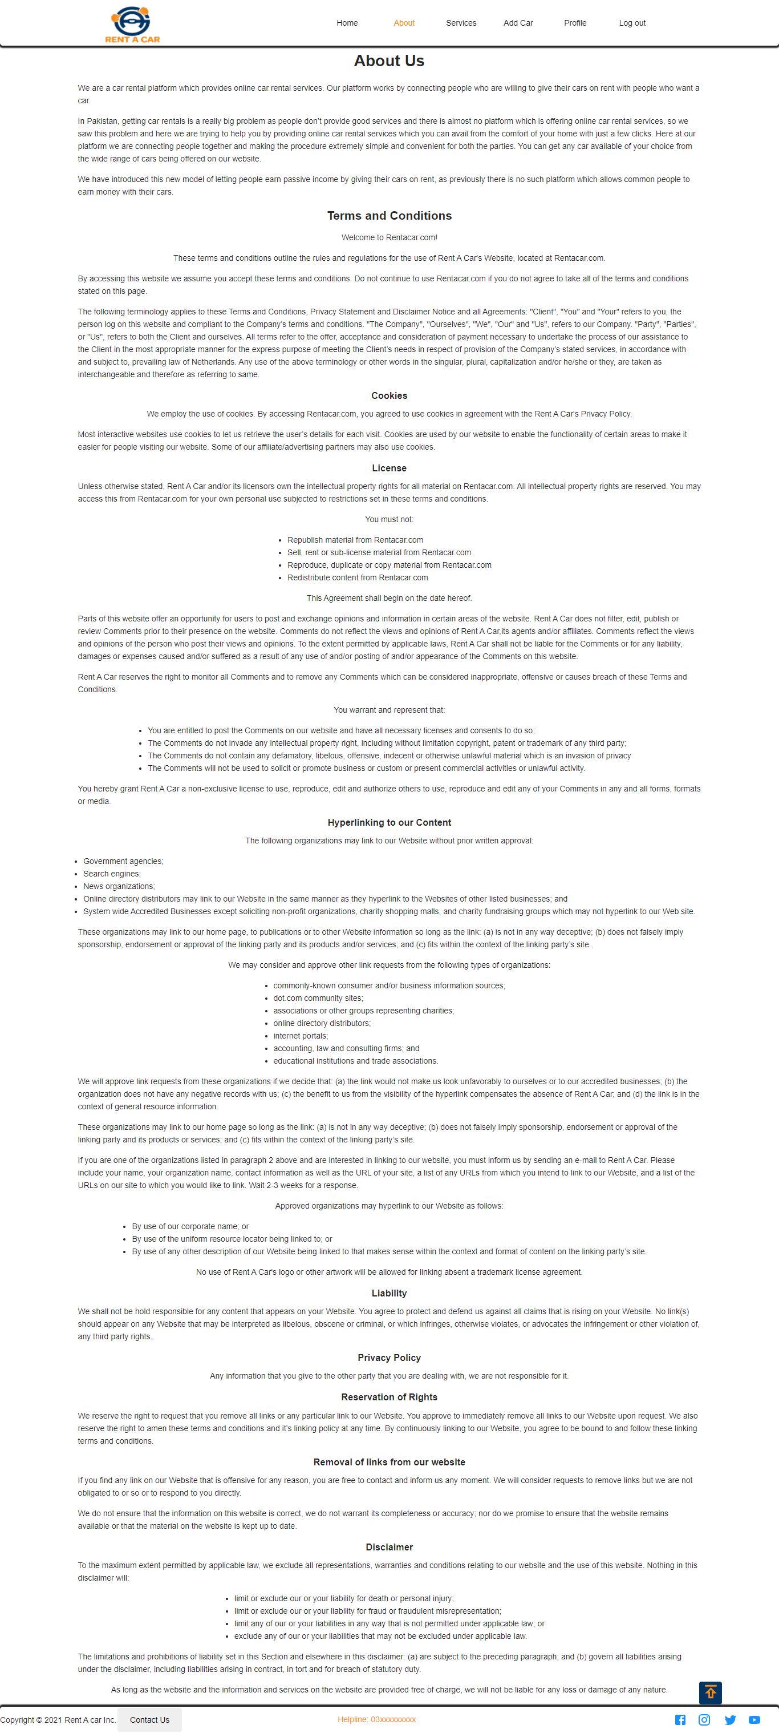
PAGE:ABOUT

Slide 18
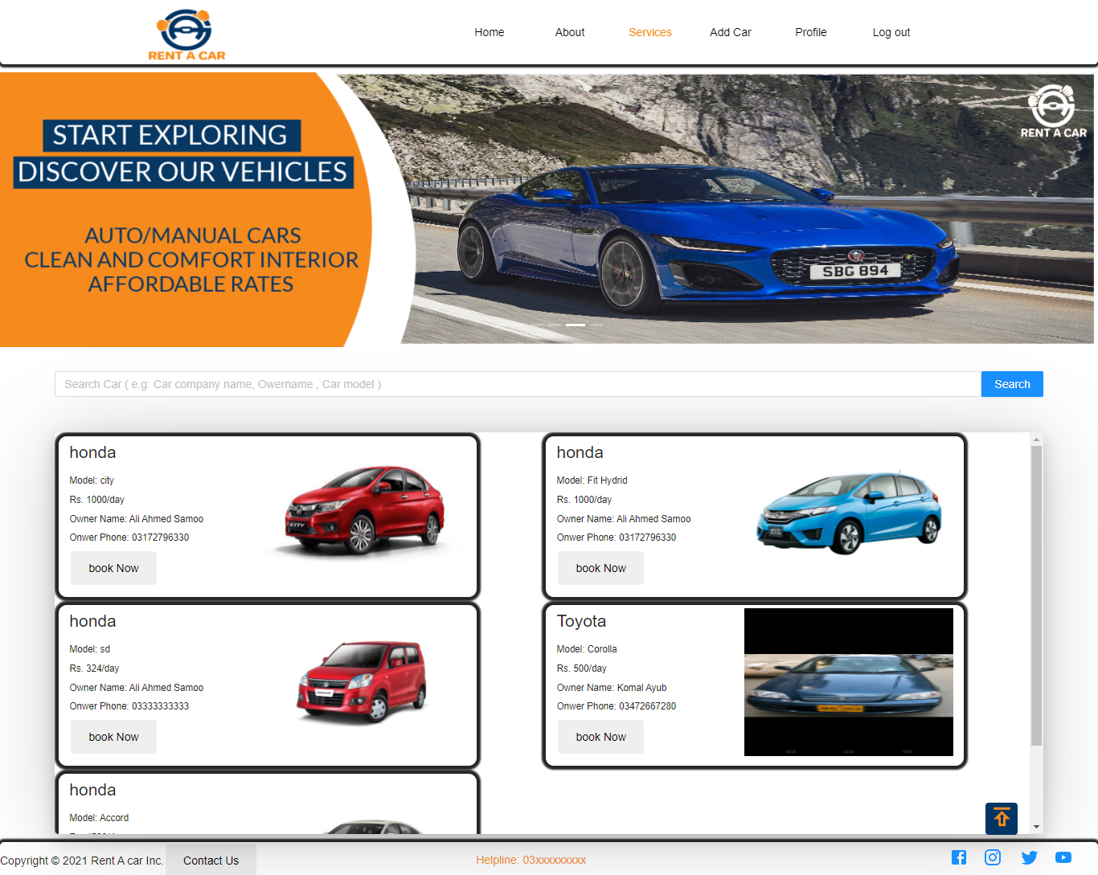
PAGE:SERVICES

Slide 19
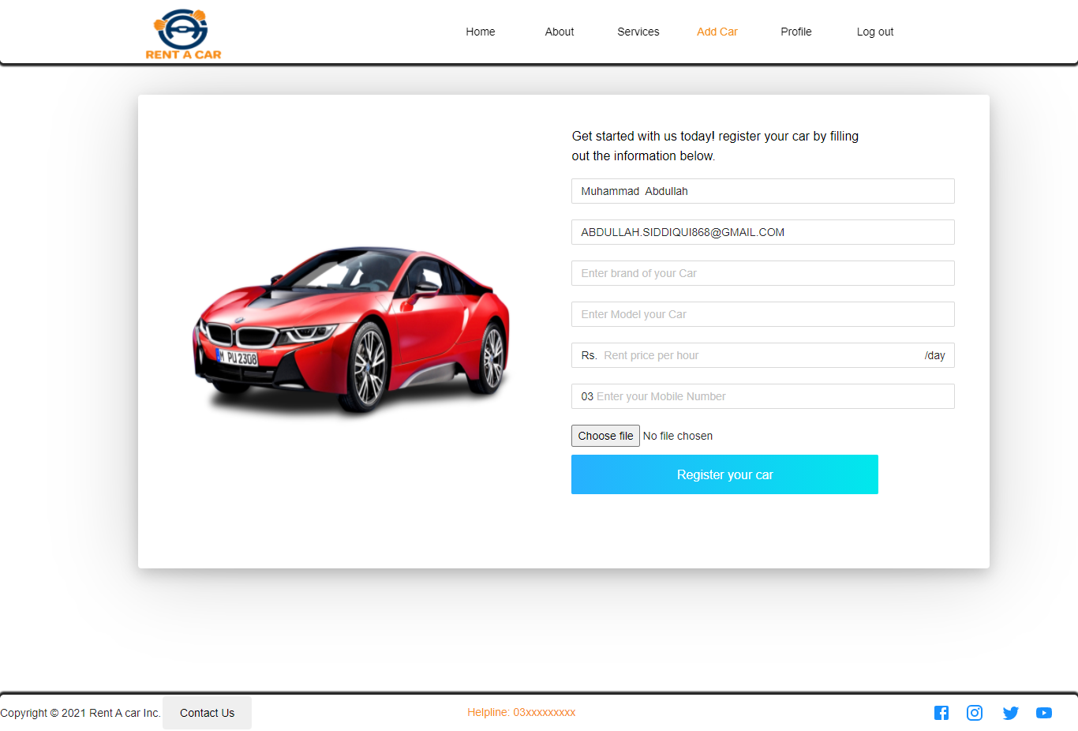
PAGE:ADD A CAR

Slide 20
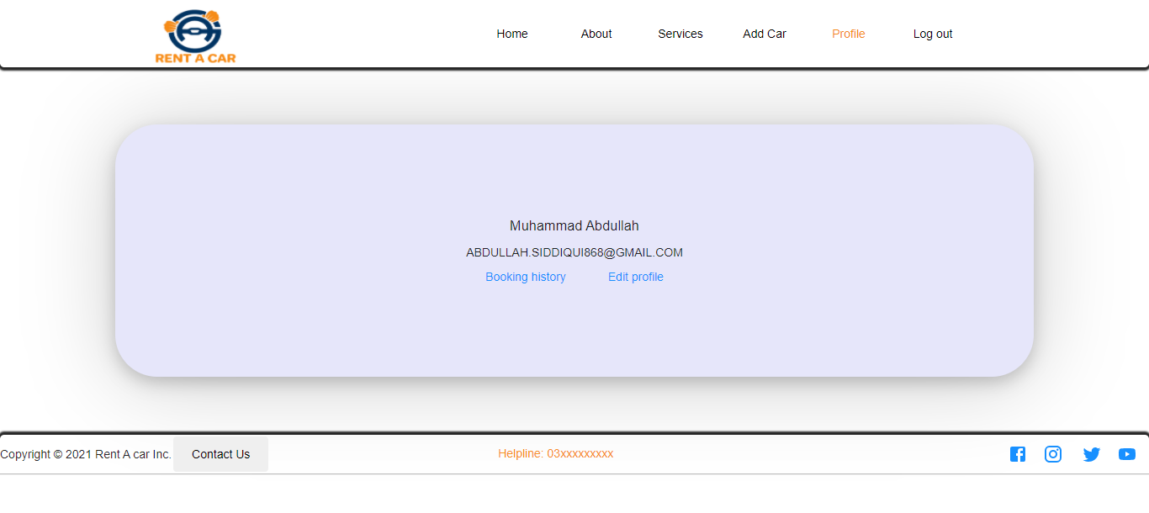
PAGE:PROFILE

Slide 21
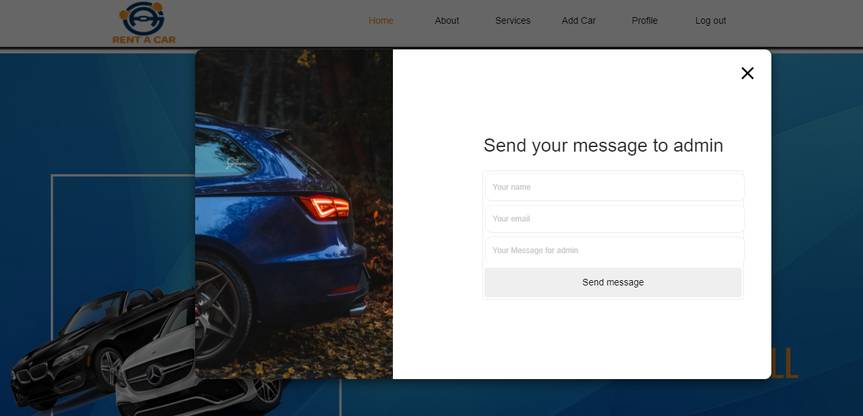
CONTACT US:

Slide 22

CONCLUSION:
Our aim is to provide user friendly website who want to take car for rent.

Slide 23


